Slide 1
Inventory management System

Slide 2
Features
Do not need to memories shop any information
Calculate all sell without any calculator
Without visiting whole shop shopkeeper can know how much product have
User can update and also delete unwanted project
Add customer
Can know how much transection did a customer

Slide 3
Working parts
I just work with only registration and login parts

Slide 4
Upcoming Working Parts
Add Customer
Sell reports create
Show customers info
Add product
Update/delete product
Calculate one customer total tarsection

Slide 5
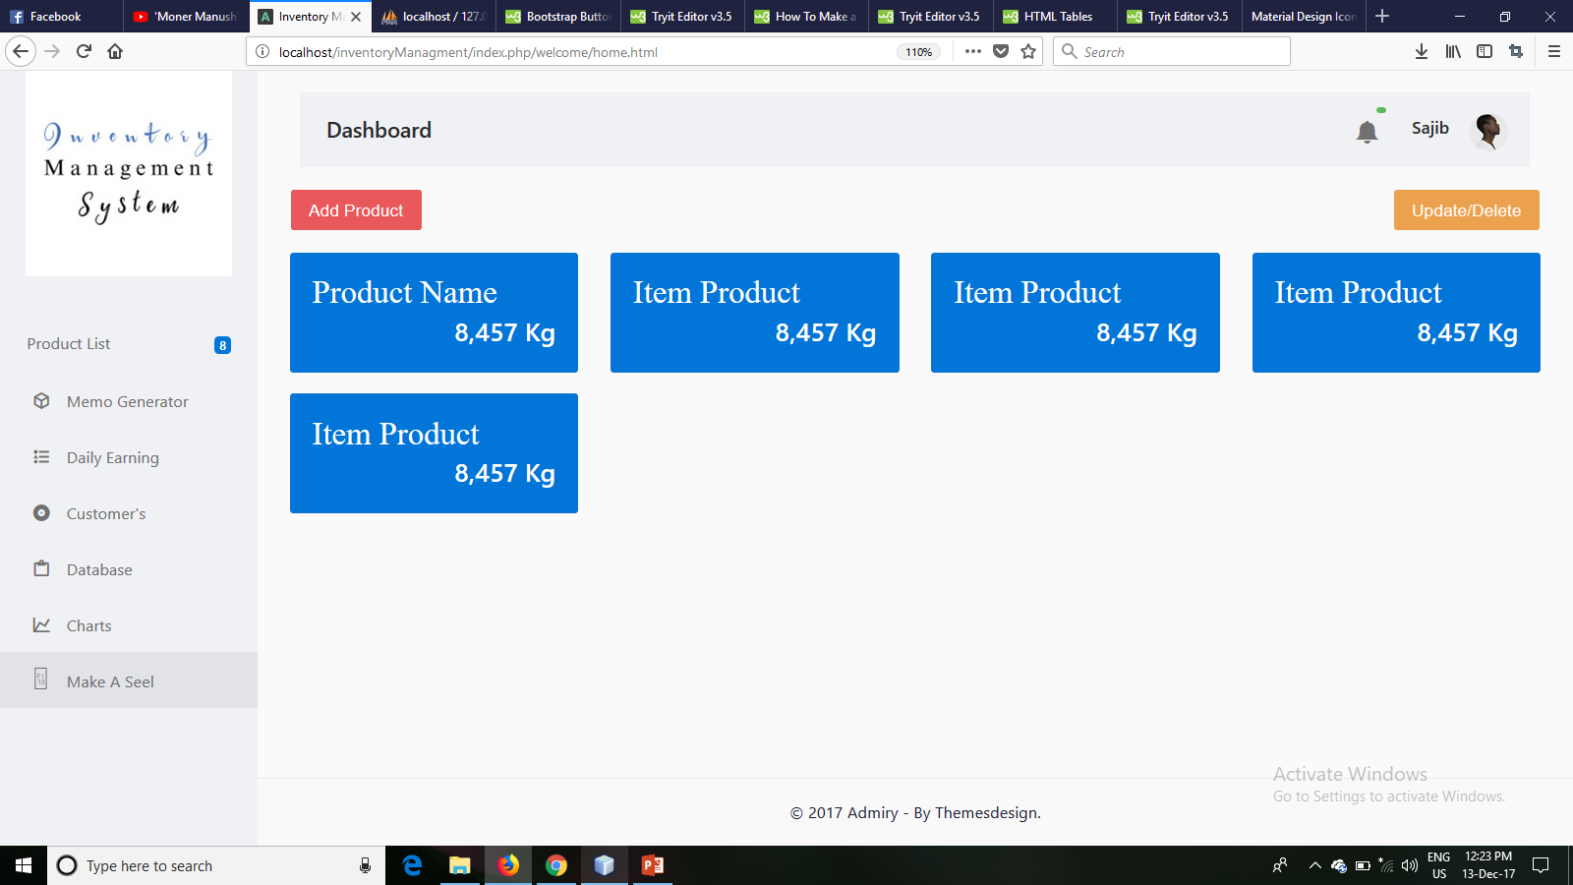
Picture Of Design

Slide 6
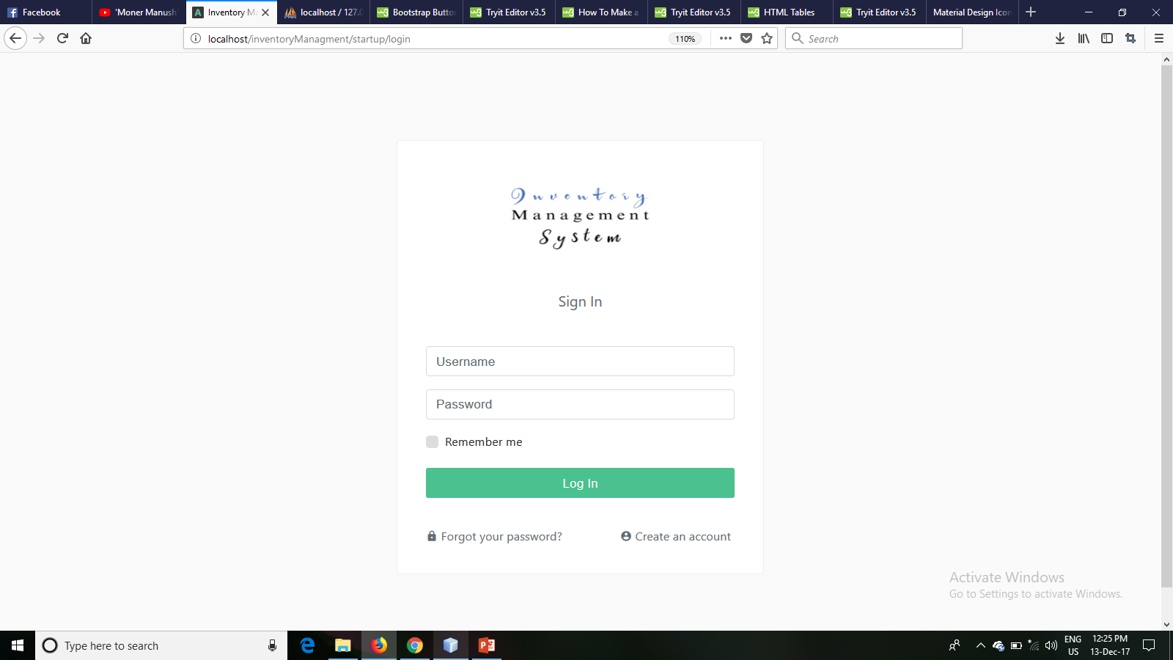
Picture Of Design

Slide 7
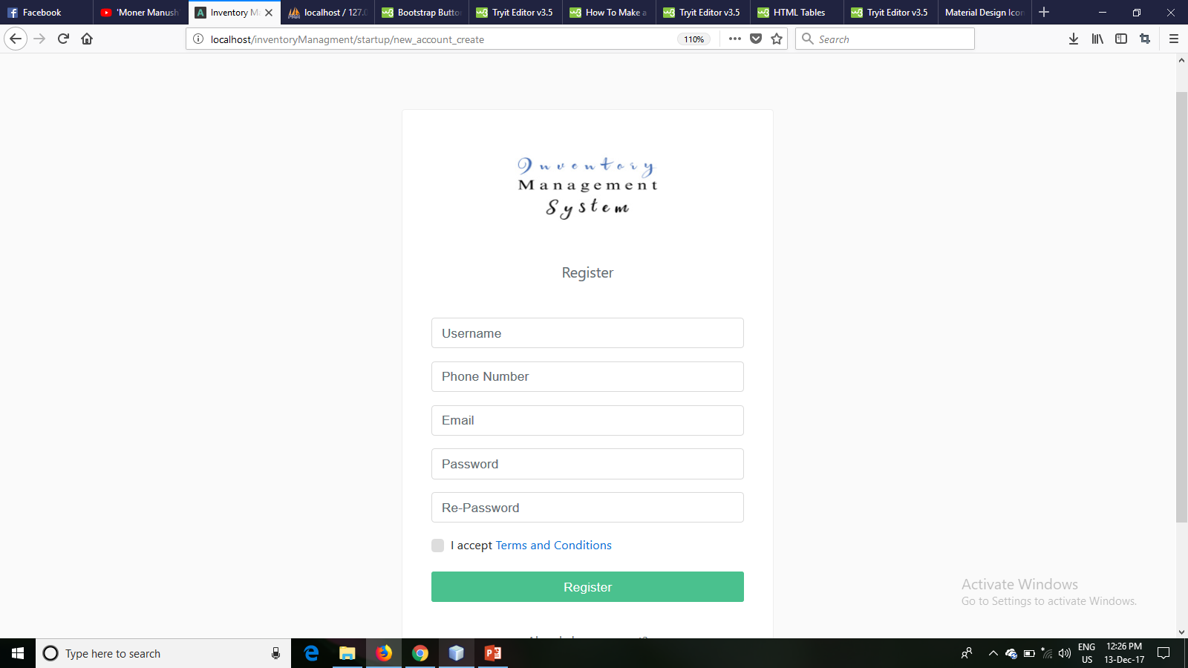
Picture Of Design

Slide 8
Code Picture

Slide 9
Database
Showing

Slide 10
Thanks

